Slide 1

SLIDE 1
Team Name:- Chetna Mind
2. Members Name and Phone Numbers:- (Kaustubh Chavan:- 8983836267)
3. Domain name:- Wearable Technology
4. Problem statement:- Fitness is one of the most important part in every individual’s life. But in today’s pandemic situation, where everybody is at home and leaving house is quite risky. For this, there should be some exercise done to keep us fit & fine. Just by walking/running and burning calories is not enough. One should be considerate about various other aspects while exercising. Some basic exercises need to be practiced to keep us in-shape.
Moreover, certain motion exercises such as push-ups and Pull-ups need to be done properly or else it might lead to serious injuries. This isn’t achieved normally without any aid.
For the same, this smart band will aid in overall exercise development.

Slide 2
SLIDE 2
ABSTRACT
Fitness is one of the most important part in every individual’s life. But in today’s pandemic situation, where everybody is at home and leaving house is quite risky. For this, there should be some exercise done to keep us fit & fine. Just by walking/running and burning calories is not enough. One should be considerate about various other aspects while exercising. Some basic exercises need to be practiced to keep us in-shape. Moreover, certain motion exercises such as Push-ups and Pull-ups need to be done properly or else it might lead to serious injuries. This isn’t achieved normally without any aid. For the same, this smart band will aid in overall exercise development. “BE FIT SMART BAND”. This is a new, innovative, accurate and user-friendly smart band which allows user to do his/her exercise properly and also to keep it’s track record daily. This band makes the user to do Push-up and Pull-up neatly and also measures his/her BPM i.e. Pulse rate. The BE FIT SMART BAND maintains precision and quality output. This band is a perfect exercise partner for every individual. Basic innovation giving advanced fitness aid for future. Fitness bands are the leading consumer products because most consumers use wearable devices to record their exercise and health statistics and progress.

Slide 3
SLIDE 3
Technical Implementation
01
02
03
Input
Processing
Output
Ultrasonic Sensor
Pulse Sensor
Arduino UNO
Timer module
Wifi Module
SPDT switch
1602 LCD Display
Buzzer

Slide 4
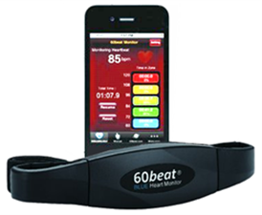
SLIDE 4
NOVELTY
Be Fit Smart Band makes the user to select type of exercise he wants to perform and count of no.’s he wants to perform that exercise. This band uses an ultrasonic sensor. This ultrasonic sensor senses the distance between the body and ground/bar and gives the count of exercise. There’s also a Pulse sensor which monitors the BPM of the user. After the completion of an exercise, there is a buzzer which blows, indicating the user that the exercise is completed.
This band also helps to keep a track record of every day's exercise and this data is stored in the users smartphone or PC.
The BE FIT SMART BAND maintains precision and quality output and it is user friendly. This makes any individual to use it easily.
This band is a perfect fitness partner for every individual.

Slide 5
SLIDE 5
HARDWARE / SOFTWARE IMPLEMENTATION
Hardware tools:
AT Mega 328P Arduino Uno:- High Performance, Low Power AVR 8-Bit Microcontroller, Advanced RISC Architecture.
HC-SR04 Ultrasonic sensor:-Ultrasonic ranging module HC-SR04 provides 2cm- 400cm non-contact measurement function, the ranging accuracy can reach to 3mm.
16x2 LCD with i2c module:-Compatible with Arduino Board or other controller board with I2C bus. • Display Type: Negative white on Blue backlight, I2C Address:0x38-0x3F.
ESP 8266 Wi-Fi module:- Low cost, compact and powerful Wi-Fi Module.
Pulse sensor:- Biometric Pulse Rate or Heart Rate detecting sensor. It is purely intended for hobby projects and should not be used for health critical applications.
DS 3231 Timer module:-Highly Accurate RTC Completely Manages All Timekeeping Functions • Real-Time Clock Counts Seconds, Minutes, Hours, Date of the Month, Month, Day of the Week, and Year, with Leap-Year Compensation.
SPDT switch:- Mechanical Life: 30,000 make-and-break cycles..
Jumper wires:-Rainbow coloured ribbon cable provides the 10 standard electrical colours to color-coded your connections. • 28AWG PVC insulated ribbon cable can be unzipped in groups to organize signals or as individual wires.
1 kΩ resistor :- 1k Resistor colour code is: - Brown, Black, Red, Gold.
Active buzzer:-Operating Voltage: 4-8V DC Sound Type: Continuous Beep .
Software tools:
Arduino IDE:- Arduino IDE is used to perform the code required for the execution of sensors required for Be Fit Smart Band. It is used to write codes for Arduino Microcontroller. It includes libraries for various sensors and components. It uses C language which is easy to write and understand.

Slide 6
SLIDE 6
EXECUTION
In this device, an Ultrasonic sensor is placed at the chest with the help of a normal belt and is connected with our Smart band. The user must first set the type of exercise he/she wants to perform and then set the no. of counts of that exercise. Then the user can start exercise. The ultrasonic sensor which is used initializes the exercise being done properly or not. The ultrasonic sensor senses and gives the count when exercise is carried out. There is also a pulse sensor connected to this band which will display the person’s BPM (Beats Per Minute). The type of exercise, its count and the BPM is displayed on the LCD screen. Once the set exercise is completed, a buzzer blows indicating that the exercise is completed. After every count, there will be minimum 20 sec of time for next count being carried out. If a person halts for more than 20 sec, there will be buzzer ringing for reminding the person to complete his/her exercise quickly. There is also a Wi-Fi module connected to this band for keeping a track record of everyday’s workout. This record will be saved and displayed on smartphone or PC.

Slide 7
SLIDE 7
BUSINESS SCOPE
Government organizations helping for funds and assembly line required for product development and marketing
Private industries/ companies manufacturing smart technology devices which are willing to bring my idea into reality working product.
NGO’s or Start-up funding organizations helping individuals to build up their projects and provide help whatever required

Slide 8
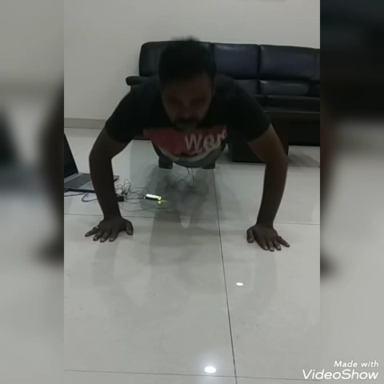
SLIDE 8
CONCLUSION
I have also made a website and a video for getting more detailed information about my Be Fit Smart Band.
Visit our website: https://coolkaustubh13.wixsite.com/befitsmartband
YouTube video link:- https://youtu.be/1JSeiRsz67s
Due to covid Pandemic and Lockdown we were unable to show pull ups exercise.

